Slide 1
Sanctified in the World
The Eschatological Context
of Sanctification

Slide 2
Romans 13:11-14
Besides this you know the time, that the hour has come for you to wake from sleep. For salvation is nearer to us now than when we first believed. 12 The night is far gone; the day is at hand. So then let us cast off the works of darkness and put on the armor of light. 13 Let us walk properly as in the daytime, not in orgies and drunkenness, not in sexual immorality and sensuality, not in quarreling and jealousy. 14 But put on the Lord Jesus Christ, and make no provision for the flesh, to gratify its desires.

Slide 3
1. We live in the overlap of the ages

Slide 4
1. We live in the overlap of the ages
The Kingdom of God in Old Testament Expectation
The Age to Come
Christ’s Coming
This Present Age

Slide 5
1. We live in the overlap of the ages
The Kingdom of God in New Testament Teaching
The future has invaded this present age in the exaltation of Christ and his gift of the Spirit.
The Age to Come
Christ’s 1st Coming
Christ’s Coming
Christ’s 2nd Coming
Inauguration
Consummation
This Present Age
We live in the overlap between this present age and the age to come. We live as people of the future between the “already” and the “not yet.”

Slide 6
1. We live in the overlap of the ages
The Kingdom of God in New Testament Teaching
The future has invaded this present age in the exaltation of Christ and his gift of the Spirit.
The Age to Come
Christ’s 1st Coming
Christ’s Coming
Christ’s 2nd Coming
Inauguration
Consummation
This Present Age
We are already justified and sanctified, but not yet glorified. We are saints, but not perfect. We are new, but not fully renewed.

Slide 7
1. We live in the overlap of the ages
The “already”
And such were some of you. But you were washed, you were sanctified, you were justified in the name of the Lord Jesus Christ and by the Spirit of our God.
--1 Corinthians 6:11

Slide 8
1. We live in the overlap of the ages
The “not yet”
Beloved, we are God’s children now, and what we will be has not yet appeared; but we know that when he appears we shall be like him, because we shall see him as he is. 3 And everyone who thus hopes in him purifies himself as he is pure.
--1 John 3:2-3

Slide 9
2. We are assailed by many foes

Slide 10
2. We are assailed by many foes
The world
“If the world hates you, know that it has hated me before it hated you. 19 If you were of the world, the world would love you as its own; but because you are not of the world, but I chose you out of the world, therefore the world hates you.
--John 15:18-19

Slide 11
2. We are assailed by many foes
The world
I have given them your word, and the world has hated them because they are not of the world, just as I am not of the world. 15 I do not ask that you take them out of the world, but that you keep them from the evil one. 16 They are not of the world, just as I am not of the world. 17 Sanctify them in the truth; your word is truth. 18 As you sent me into the world, so I have sent them into the world. 19 And for their sake I sanctify myself, that they also may be sanctified in truth.
--John 17:14-19

Slide 12
2. We are assailed by many foes
The world
You adulterous people! Do you not know that friendship with the world is enmity with God? Therefore whoever wishes to be a friend of the world makes himself an enemy of God.
--James 4:4

Slide 13
2. We are assailed by many foes
The flesh
Beloved, I urge you as sojourners and exiles to abstain from the passions of the flesh, which wage war against your soul.
--1 Peter 2:11

Slide 14
2. We are assailed by many foes
The flesh
For the desires of the flesh are against the Spirit, and the desires of the Spirit are against the flesh, for these are opposed to each other, to keep you from doing the things you want to do.
--Galatians 5:17

Slide 15
2. We are assailed by many foes
The flesh
For we know that the law is spiritual, but I am of the flesh, sold under sin. 15 For I do not understand my own actions. For I do not do what I want, but I do the very thing I hate. 16 Now if I do what I do not want, I agree with the law, that it is good. 17 So now it is no longer I who do it, but sin that dwells within me. 18 For I know that nothing good dwells in me, that is, in my flesh. For I have the desire to do what is right, but not the ability to carry it out. 19 For I do not do the good I want, but the evil I do not want is what I keep on doing.

Slide 16
2. We are assailed by many foes
The flesh
20 Now if I do what I do not want, it is no longer I who do it, but sin that dwells within me. 21 So I find it to be a law that when I want to do right, evil lies close at hand. 22 For I delight in the law of God, in my inner being, 23 but I see in my members another law waging war against the law of my mind and making me captive to the law of sin that dwells in my members. 24 Wretched man that I am! Who will deliver me from this body of death?
--Romans 7:14-24

Slide 17
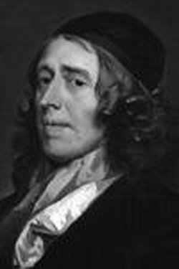
If [indwelling sin] came upon the soul only at certain seasons, much obedience might be perfectly accomplished in its absence; yea, and as they deal with usurping tyrants, whom they intend to thrust out of a city, the gates might be sometimes shut against it, that it might not return,—the soul might fortify itself against it. But the soul is its home; there it dwells, and is no wanderer. Wherever you are, whatever you are about, this law of sin is always in you; in the best that you do, and in the worst. Men little consider what a dangerous companion is always at home with them. When they are in company, when alone, by night or by day, all is one, sin is with them. There is a living coal continually in their houses; which, if it be not looked unto, will fire them, and it may be consume them.
-John Owen, Of the Nature, Power, Deceit, and Prevelancy of Indwelling Sin

Slide 18
2. We are assailed by many foes
The devil
Be sober-minded; be watchful. Your adversary the devil prowls around like a roaring lion, seeking someone to devour.
--1 Peter 5:8

Slide 19
2. We are assailed by many foes
The devil
Finally, be strong in the Lord and in the strength of his might. 11 Put on the whole armor of God, that you may be able to stand against the schemes of the devil. 12 For we do not wrestle against flesh and blood, but against the rulers, against the authorities, against the cosmic powers over this present darkness, against the spiritual forces of evil in the heavenly places.
--Ephesians 6:10-12

Slide 20
2. We are assailed by many foes
DEVIL
Sin Within
The world, the flesh, and the devil

Slide 21
3. We, therefore, live as…

Slide 22
3. We, therefore, live as…
Pilgrims on a journey
Beloved, I beg you as sojourners and pilgrims, abstain from fleshly lusts which war against the soul
--1 Peter 2:11, NKJV

Slide 23
3. We, therefore, live as…
Pilgrims on a journey
These all died in faith, not having received the promises, but having seen them afar off were assured of them, embraced them and confessed that they were strangers and pilgrims on the earth.
--Hebrews 11:13, NKJV

Slide 24
3. We, therefore, live as…
Athletes in a race
Therefore, since we are surrounded by so great a cloud of witnesses, let us also lay aside every weight, and sin which clings so closely, and let us run with endurance the race that is set before us, 2 looking to Jesus, the founder and perfecter of our faith, who for the joy that was set before him endured the cross, despising the shame, and is seated at the right hand of the throne of God.
--Hebrews 12:1-2

Slide 25
3. We, therefore, live as…
Athletes in a race
Do you not know that in a race all the runners run, but only one receives the prize? So run that you may obtain it. 25 Every athlete exercises self-control in all things. They do it to receive a perishable wreath, but we an imperishable. 26 So I do not run aimlessly; I do not box as one beating the air. 27 But I discipline my body and keep it under control, lest after preaching to others I myself should be disqualified.
--1 Corinthians 9:24-27

Slide 26
3. We, therefore, live as…
Athletes in a race
Not that I have already obtained this or am already perfect, but I press on to make it my own, because Christ Jesus has made me his own. 13 Brothers, I do not consider that I have made it my own. But one thing I do: forgetting what lies behind and straining forward to what lies ahead,14 I press on toward the goal for the prize of the upward call of God in Christ Jesus.
--Philippians 3:12-14

Slide 27
3. We, therefore, live as…
Soldiers in a battle
Share in suffering as a good soldier of Christ Jesus. 4 No soldier gets entangled in civilian pursuits, since his aim is to please the one who enlisted him.
--2 Timothy 2:3-4

Slide 28
3. We, therefore, live as…
Soldiers in a battle
For though we walk in the flesh, we are not waging war according to the flesh. 4 For the weapons of our warfare are not of the flesh but have divine power to destroy strongholds.
--2 Corinthians 10:3-4

Slide 29
3. We, therefore, live as…
Soldiers in a battle
Therefore take up the whole armor of God, that you may be able to withstand in the evil day, and having done all, to stand firm. 14 Stand therefore, having fastened on the belt of truth, and having put on the breastplate of righteousness, 15 and, as shoes for your feet, having put on the readiness given by the gospel of peace. 16 In all circumstances take up the shield of faith, with which you can extinguish all the flaming darts of the evil one; 17 and take the helmet of salvation, and the sword of the Spirit, which is the word of God
--Ephesians 6:13-17

Slide 30
Application
These pictures teach us several things:

Slide 31
Application
These pictures teach us several things:
Growth is a process

Slide 32
Application
These pictures teach us several things:
Growth is a process
Effort is required

Slide 33
Application
These pictures teach us several things:
Growth is a process
Effort is required
Conflict is normal

Slide 34
Application
These pictures teach us several things:
Growth is a process
Effort is required
Conflict is normal
Watchfulness is needed

Slide 35
Application
These pictures teach us several things:
Growth is a process
Effort is required
Conflict is normal
Watchfulness is needed
Faith is essential

Slide 36
Application
These pictures teach us several things:
Growth is a process
Effort is required
Conflict is normal
Watchfulness is needed
Faith is essential
Victory is sure

Slide 37
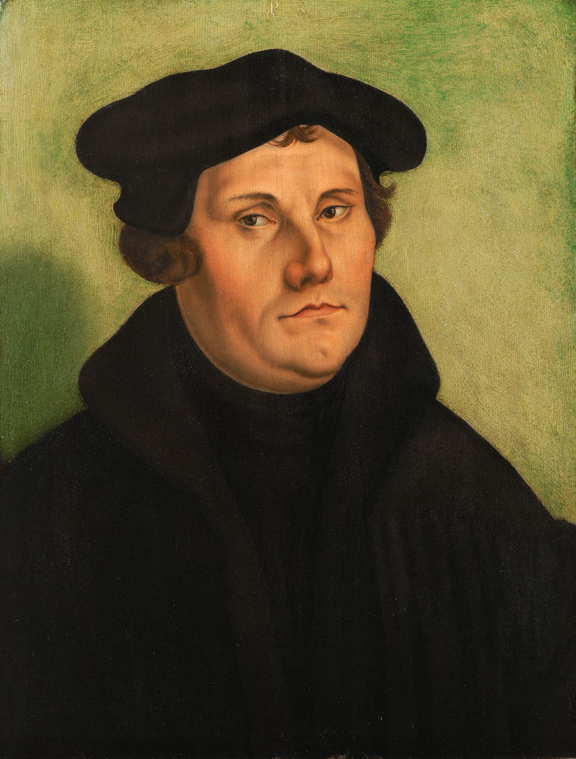
This life, therefore, is not righteous-ness, but growth in righteousness; not health, but healing; not being, but becoming; not rest, but exercise. We are not yet what we shall be, but we are growing toward it. The process is not yet finished, but it is going on. This is not the end, but it is the road. All does not yet gleam in glory, but all is being purified.
--Martin Luther

